Slide 1

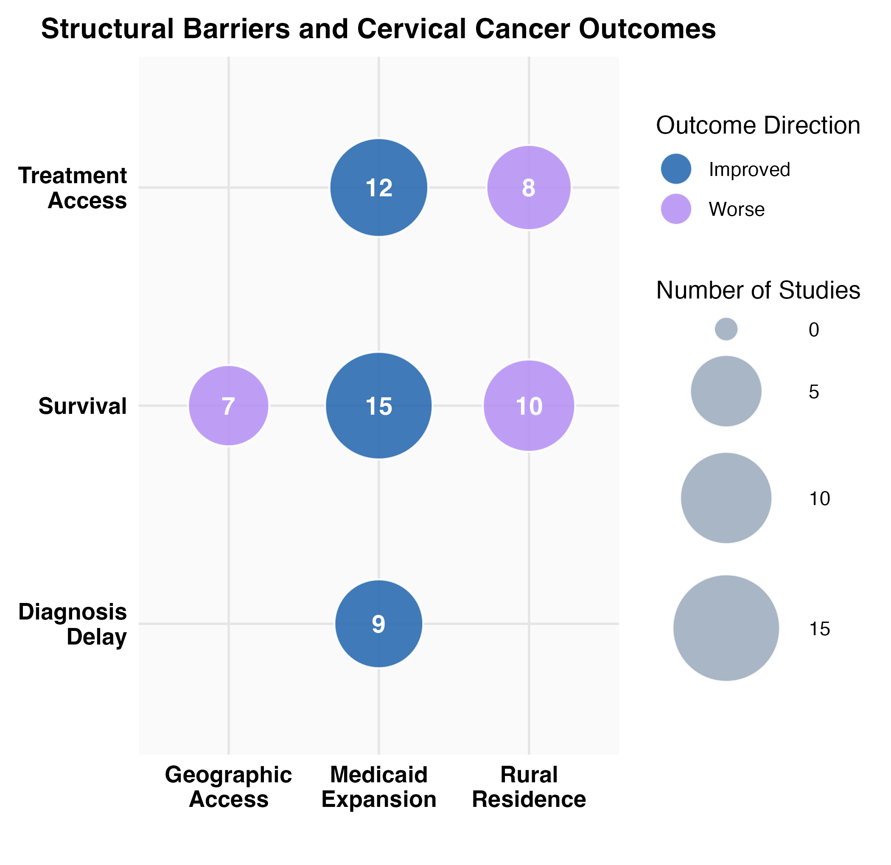
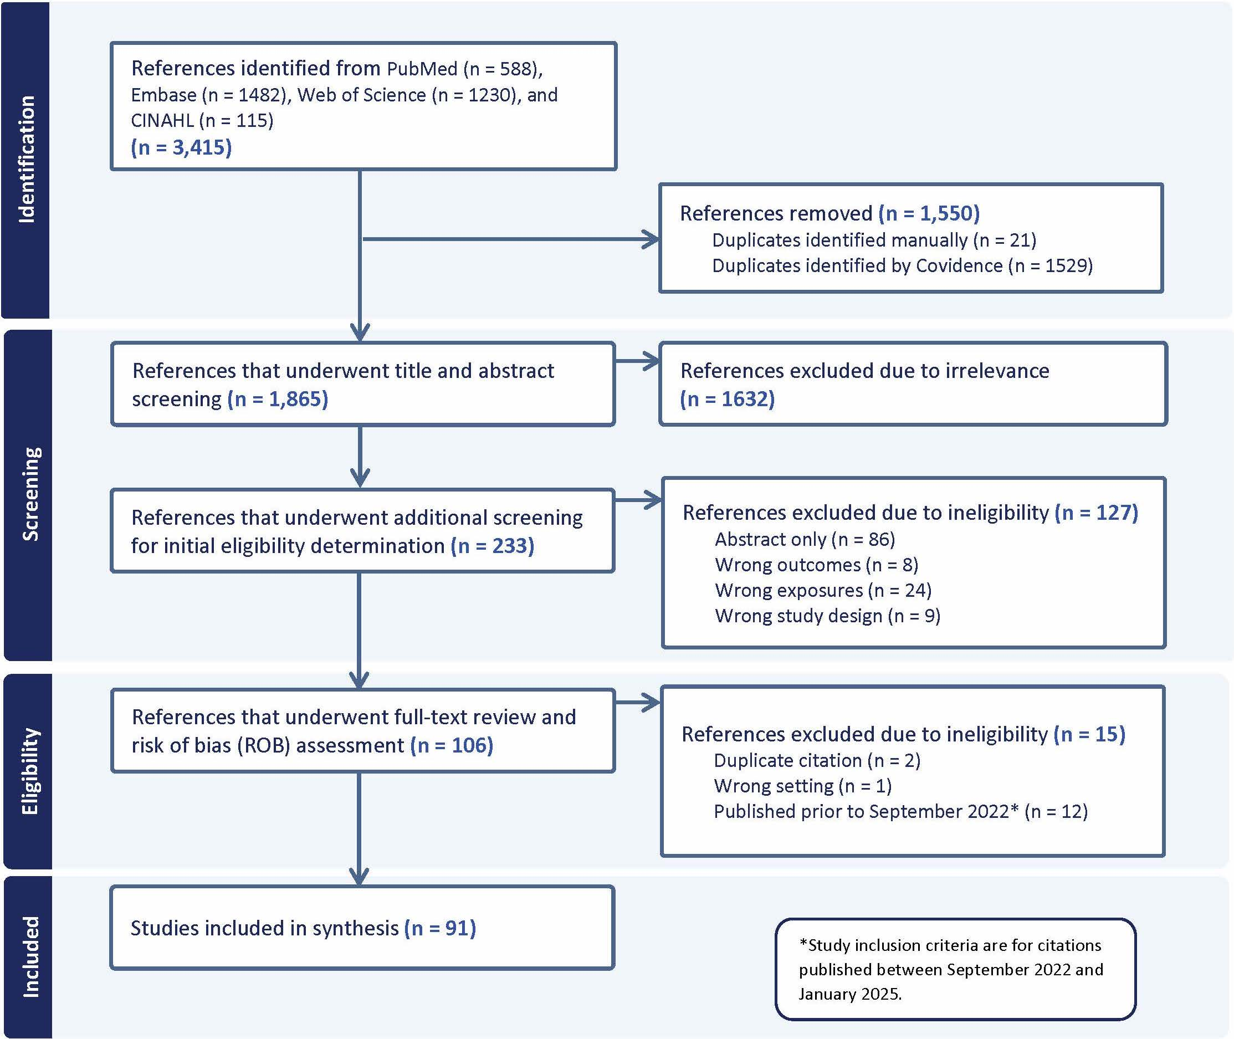


Geographic and Policy-Level Barriers in Cervical Cancer Care: A Systematic Review of Structural Racism and Survival Outcomes
Sukhman Parhar¹, Amber Rockson¹, Alexis Schaefer¹, Zihan Xiong¹, Mila Cordero¹, Ngozi C. Obi^{1,2}, Sarah O’Shea³, Jessica Y. Islam⁵, Jennifer Tsui^{6,7}, & Adana A. M. Llanos^{1,4}
BACKGROUND
RESULTS
Cervical cancer disproportionately affects marginalized U.S. populations.
Structural racism in health systems drives inequities in survival.
Policy and geographic barriers—Medicaid expansion, distribution of treatment centers, safety-net hospital reliance—shape outcomes.
Identifying upstream drivers is critical for equity.
Preliminary findings suggest that Medicaid expansion is associated with improved access to treatment and reduced disparities in survival, while lack of expansion is linked to delayed diagnosis and treatment initiation. Geographic inequities, particularly rural residence and limited access to comprehensive cancer centers, were consistently associated with poorer outcomes. These barriers disproportionately affect Black, Latina, and Indigenous women
PROJECT AIMS
Synthesize evidence on how structural racism influences cervical cancer care and survival.
Focus: Geographic & policy barriers
Assess effects on treatment initiation and survival.
DESIGN and METHODS
Systematic review
Data sources: PubMed, CINAHL, Web of Science, Embase (English-language, 2022–2025)
Screening & extraction in Covidence
Variables: demographics, structural barriers, cancer outcomes.
NEXT STEPS
The review highlights how structural racism shapes cervical cancer care and survival, identifying where inequities are most pronounced. Ongoing synthesis will refine coding of policy and geographic barriers, with data displayed in descriptive tables to identify evidence gaps. Findings will inform actionable policy reforms, including Medicaid expansion and investment in safety-net systems, advancing equity in cancer care
REFERENCES and ACKNOWLEDGEMENTS
EPIDEMIOLOGY COMPETENCIES I APPLIED
We thank Marian LaForest for her contributions to the literature search that supported this work.
Supported by the National Institute on Minority Health and Health Disparities (NIMHD) grant 1R01MD018250-01
Competency | I applied it by. . .
Appraise epidemiological literature critically | I systematically reviewed and evaluated peer-reviewed studies on structural racism and cervical cancer care using Covidence, PubMed, and citation management tools. I assessed study quality, extracted relevant data, and translated findings into thematic categories for synthesis and policy implications.
Analyze public health problems in terms of magnitude, distribution, and determinants | I examined how geographic and policy-level structural racism contributes to disparities in cervical cancer treatment and survival, assessing the distribution of barriers across populations and settings, with a focus on Medicaid expansion and rural versus urban differences

